Slide 1
Uploading Conditions

Slide 2
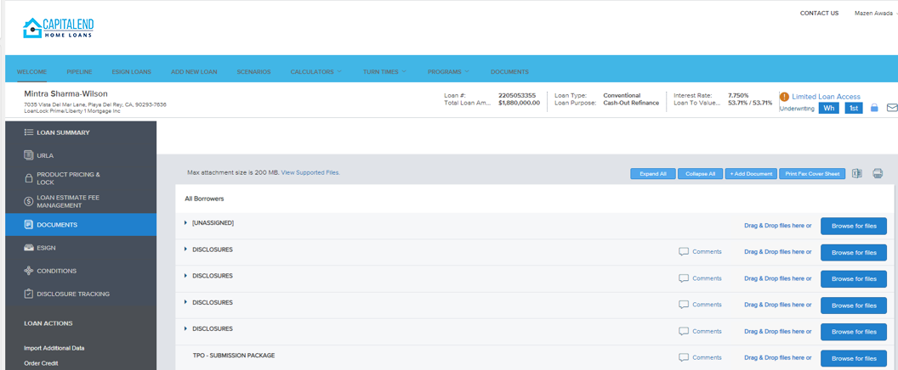
To upload conditions, go to DOCUMENTS section.
Drag and drop your documents to the UNASSIGNED folder.
Be sure to email your Account Managers and CC your Account Executive once upload is finished.
1
2
Please Note: Account Manager is responsible for filing conditions in respective buckets and attaching to UW condition

